Slide 1
SUPERVISOR & INTERVIEWER | MENUS
NPHC 2024 TRAINING

Slide 2
Introduction
A MENU is an application module that controls all the applications that will be used in the enumeration exercise of NPHC 2024
Its divided into two parts the Interviewer menu and the supervisor menu

Slide 3
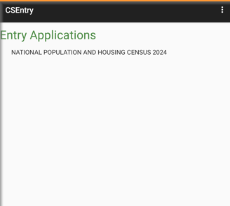
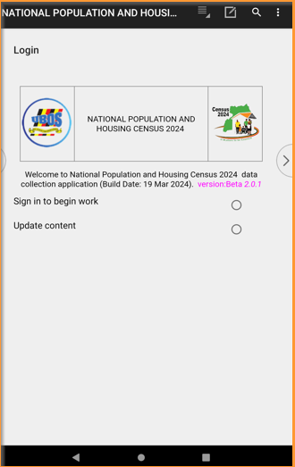
Supervisor
Entry Application
Login

Slide 4
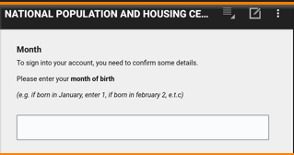
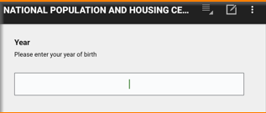
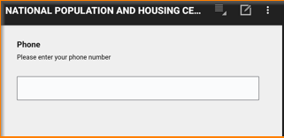
Verification of login details
Carefully enter month, year of birth and your telephone number to begin interview

Slide 5
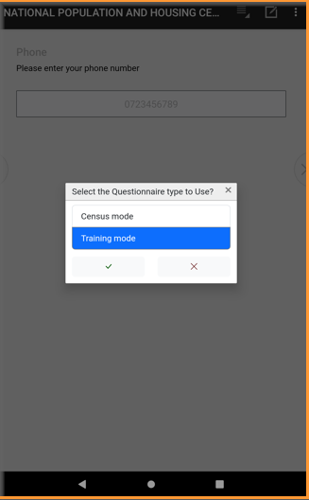
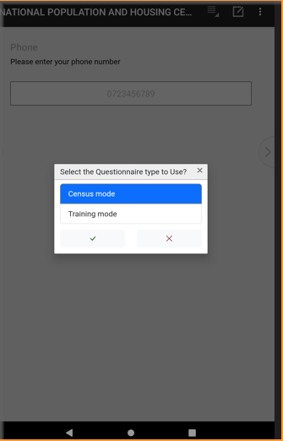
Selecting the Mode
Training Mode
Census Mode

Slide 6
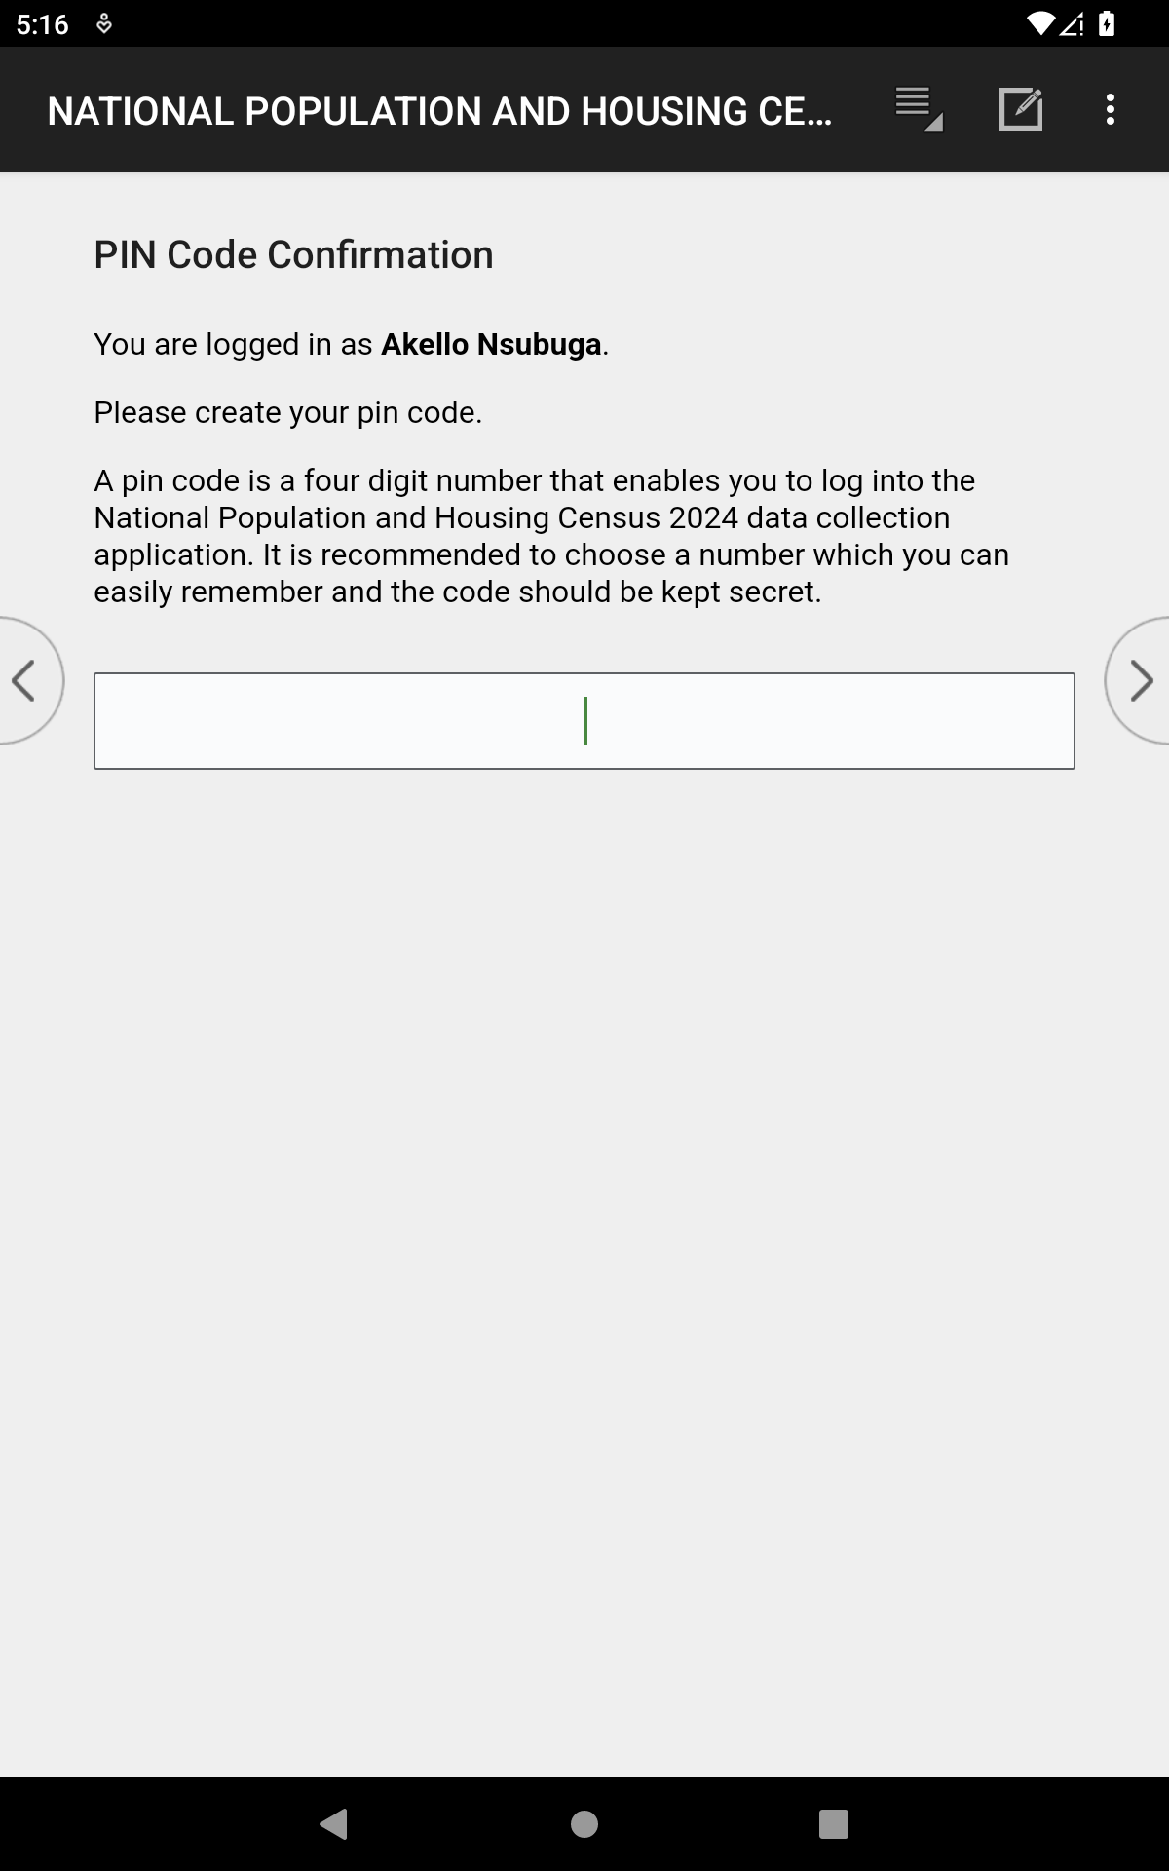
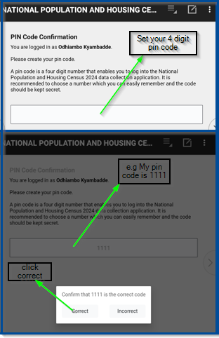
Pin Code
Set your 4 digit pin code
Notes:
A new screenshot with comments outside

Slide 7
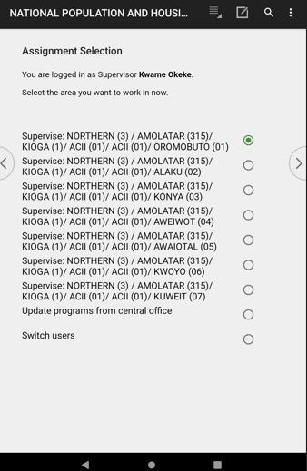
Supervisor Assignment
Select the Village to apply a community questionnaire
Update and switch users

Slide 8
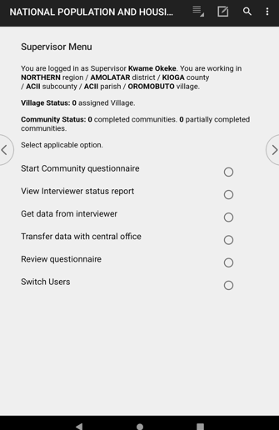
Supervisor Menu: Start Community Questionnaire
Select start community questionnaire to start interviewing
Notes:
Include a screenshot for viewing the status report

Slide 9
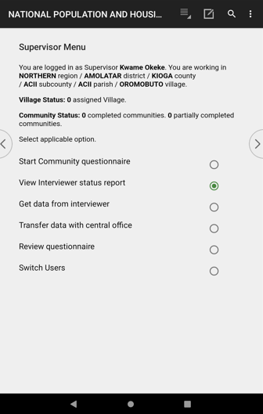
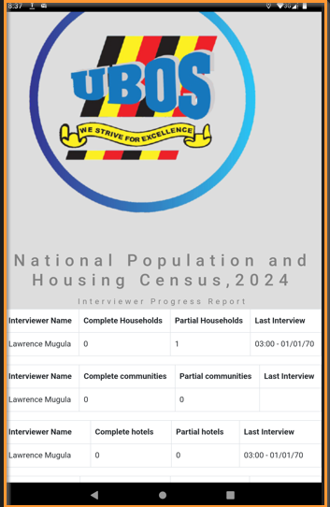
Supervisor Menu: View Status Report
Notes:
Include a screenshot for viewing the status report

Slide 10
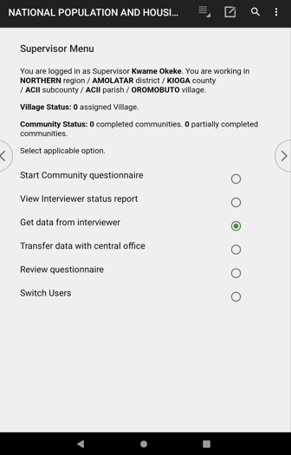
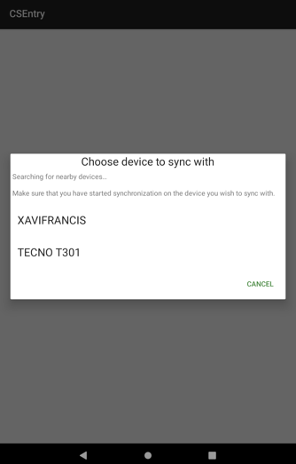
Supervisor Menu: Get data from interviewer

Slide 11
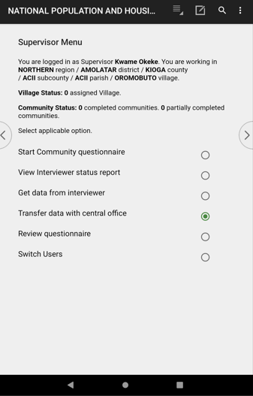
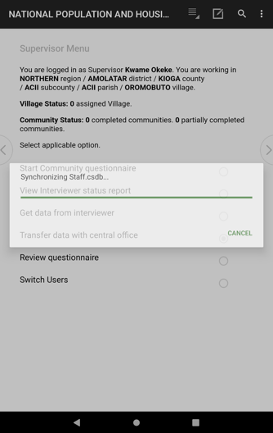
Supervisor Menu: Transfer data with central office
Notes:
Missing screenshot for review questionnaire

Slide 12


Supervisor Menu
Any Questions

Slide 13
INTERVIEWER | MENU
NPHC 2024 TRAINING

Slide 14
Interviewer
Entry Application
Login

Slide 15
Verification of login details
Carefully enter month, year of birth and your telephone number to begin interview

Slide 16
Selecting the Mode
Training Mode
Census Mode

Slide 17
Pin Code
Set your four (4) digit pin code
Notes:
A new screenshot with comments outside

Slide 18
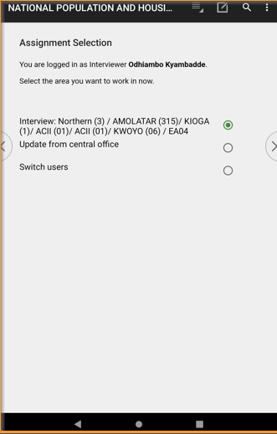
Interviewer Assignment
Select EA to start work
Confirm that you are in the correct EA.

Slide 19
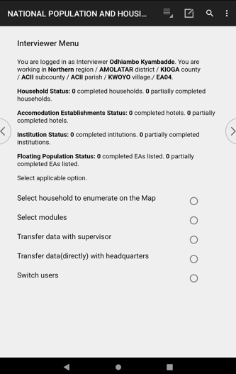
Interviewer Menu (1/6)
1.Summary of questionnaires done
To view all the questionnaires so far tempted
2.Select Household to enumerate on the map
To start enumerating your EA by selecting particular households on the map
3.Select Module
To view questionnaires and to continue interviewing if not complete
To start interviewing other questionnaires
To add a new household structure that does not appear on the EA map
4.Transfer data with supervisor
Transfer all the data collected to the supervisor
5.Transfer data (directly) with Headquarter
Send collected data to the Head quarter servers
6.Switch users
Exit current user to log in as another person
1
2
3
4
5
6

Slide 20
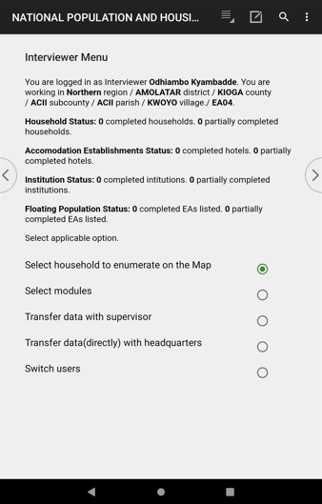
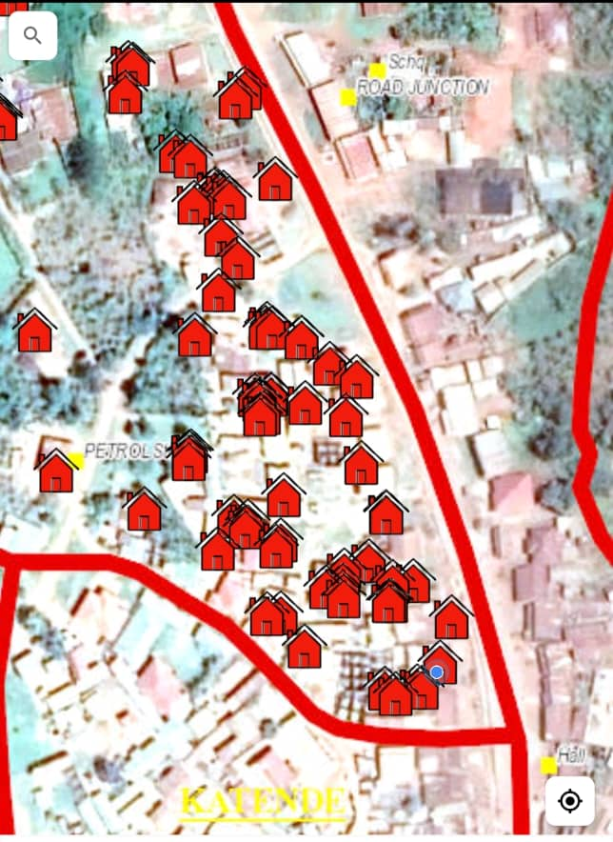
Select Household to enumerate (2/6)
Notes:
Waiting on screenshot from Butambala

Slide 21
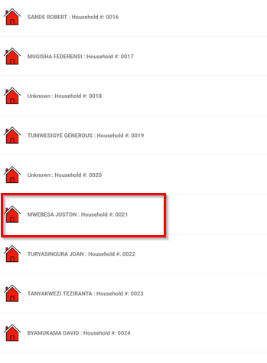
Select Household to enumerate (2/6)
All Households within the EA will populate
Tap/Click the household to begin with
All listed HHs during listing are automatically populated

Slide 22
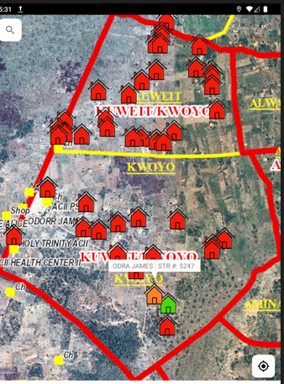
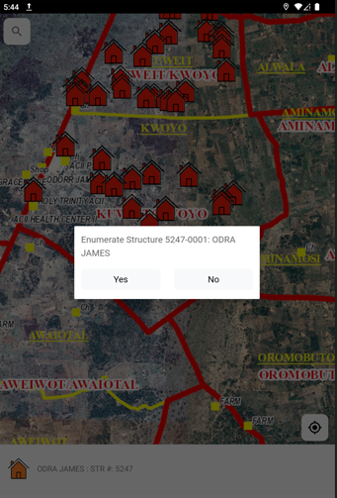
Select Household to enumerate (2/6)
Select Yes if that is the HH to interview

Slide 23
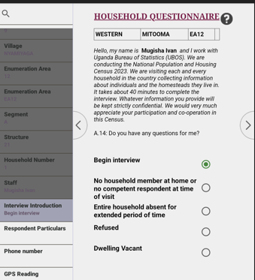
Begin a house hold interview
Begin interview!

Slide 24
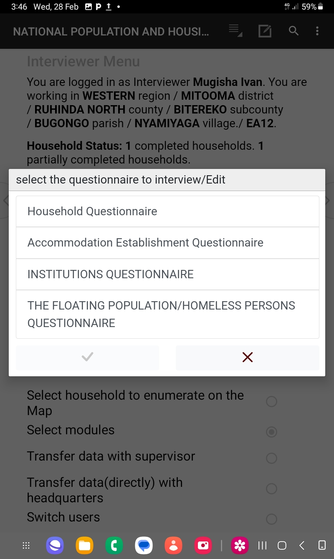
Interviewer Menu (2/6)
Option 3: View questionnaire allows you to select any questionnaire to start interviewing E.g. Institutions Questionnaire

Slide 25
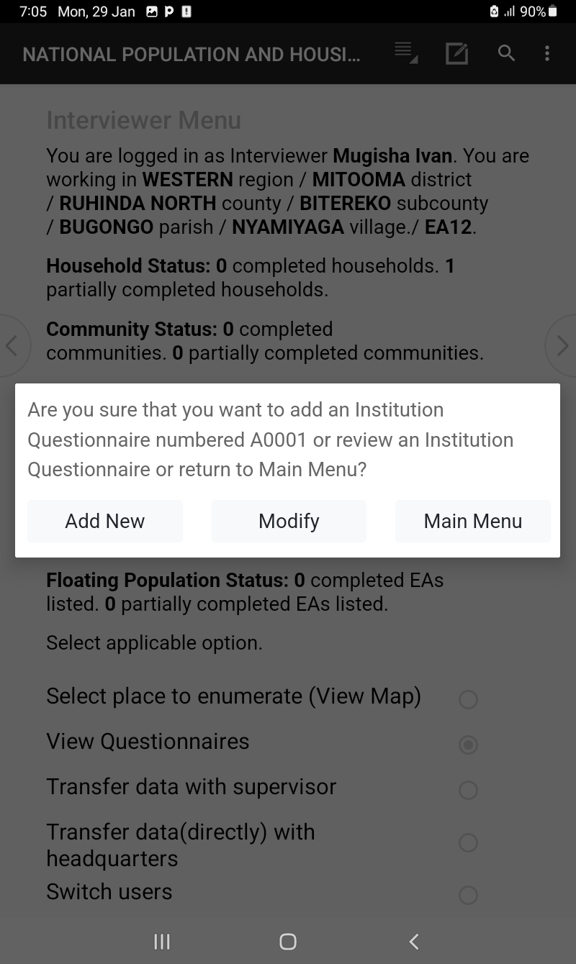
Interviewer Menu (3/6)
After selecting the institutional questionnaire, decide on whether to add new questionnaire, or modify the existing questionnaires, or return back to the interviewer menu

Slide 26
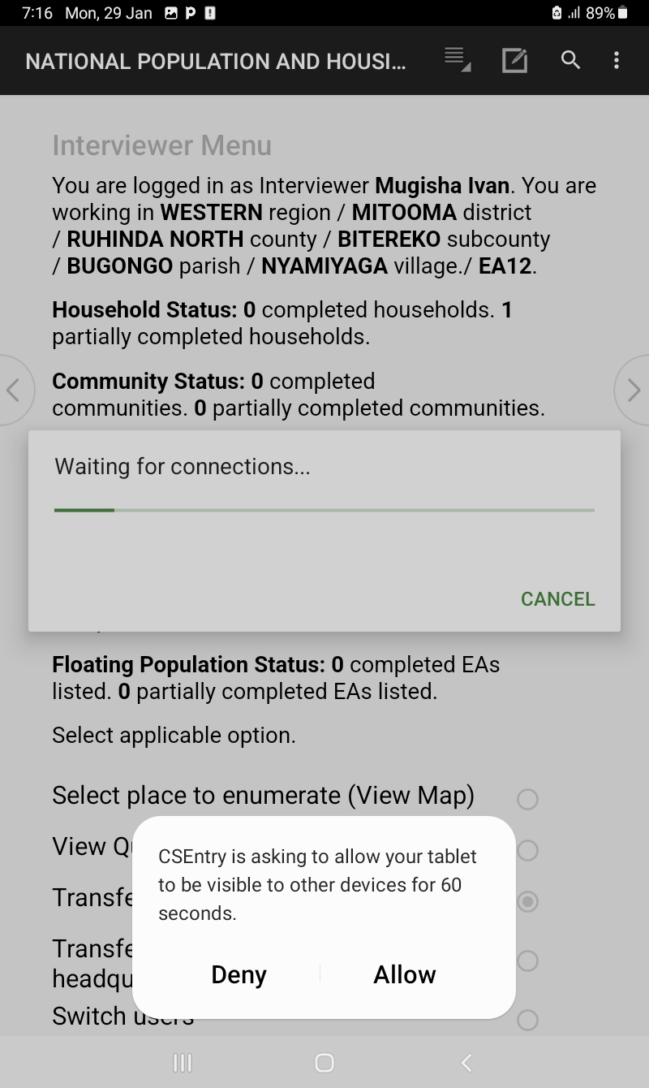
Interviewer Menu (4/6)
Option 4: Allows you to transfer your data to your supervisor

Slide 27
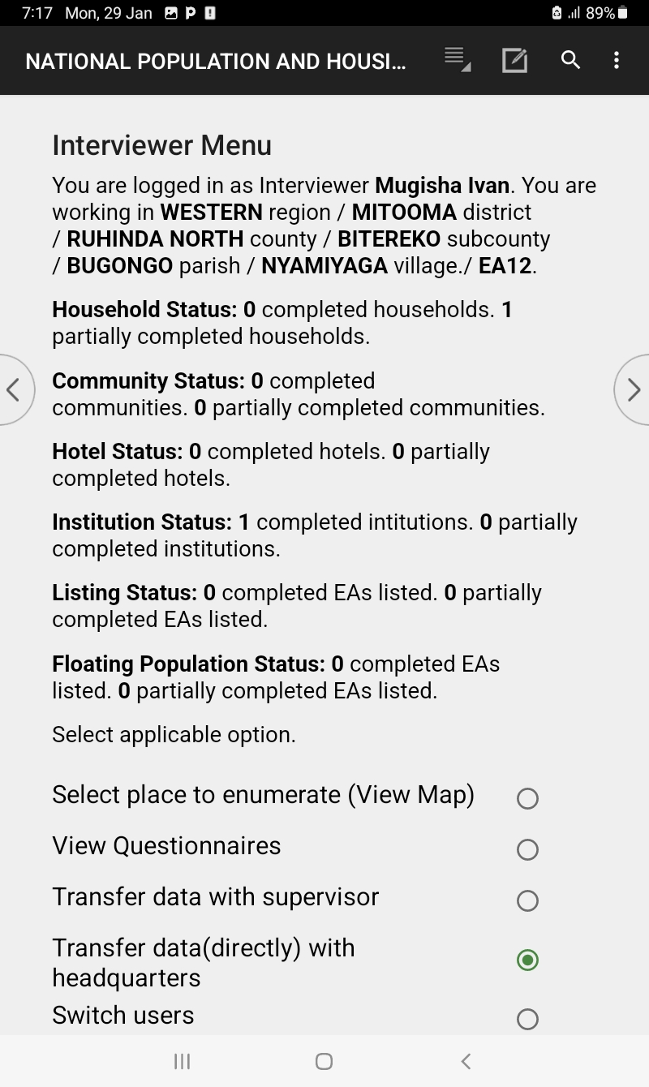
Interviewer Menu (5/6)
Option 5: Allows you to transfer your data to the headquarter servers

Slide 28
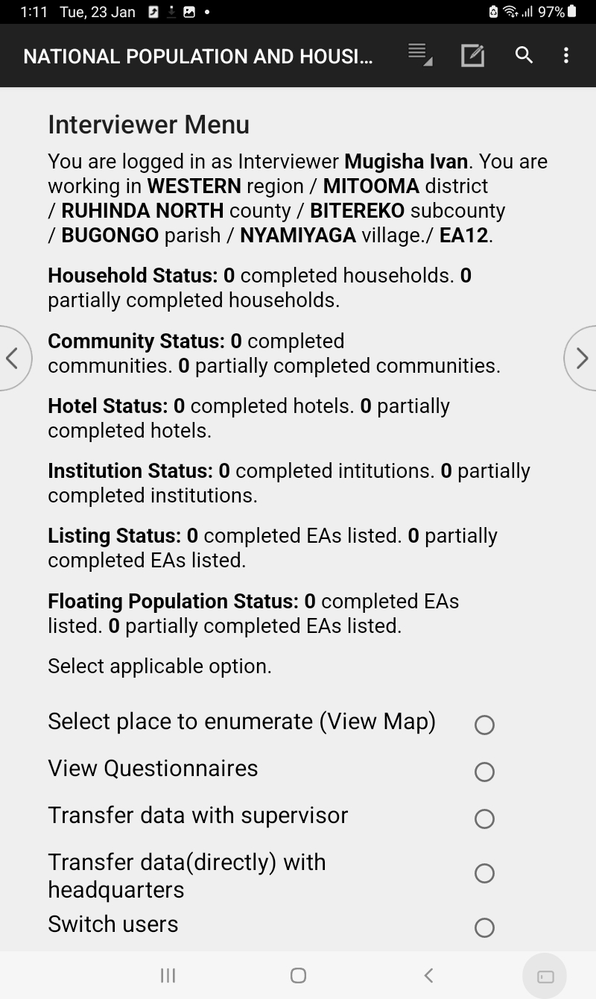
Interviewer Menu (6/6)
Option 6: Allows you to exit the menu to the login screen

Slide 29
Thank You
Any Questions

