Slide 1


PRELIMINARY RESULTS
Chris N Mukiza (PhD)
Executive Director | Census Commissioner
Uganda Bureau of Statistics
Serena Hotel, Kampala
27th June 2024
Notes:
Add venue and time

Slide 2
PRESENTATION OUTLINE
1
INTRODUCTION
2
CHALLENGES FACED
3
SUCCESS STORY
4
CENSUS 2024 PRELIMINARY RESULTS
5
CONCLUSION

Slide 3

INTRODUCTION
The Population and Housing Census is the largest peacetime national operation
Main source of demographic and socio-economic data and statistical information for planning and evidence based decision making
Demographic and socio-economic data were collected from households, institutions and communities
Longest household and Community questionnaire aimed at collecting comprehensive information as demanded by stakeholders
Notes:
Confirm across countries

Slide 4
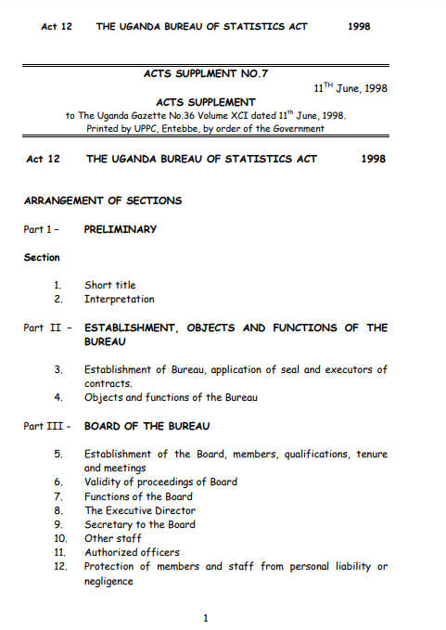
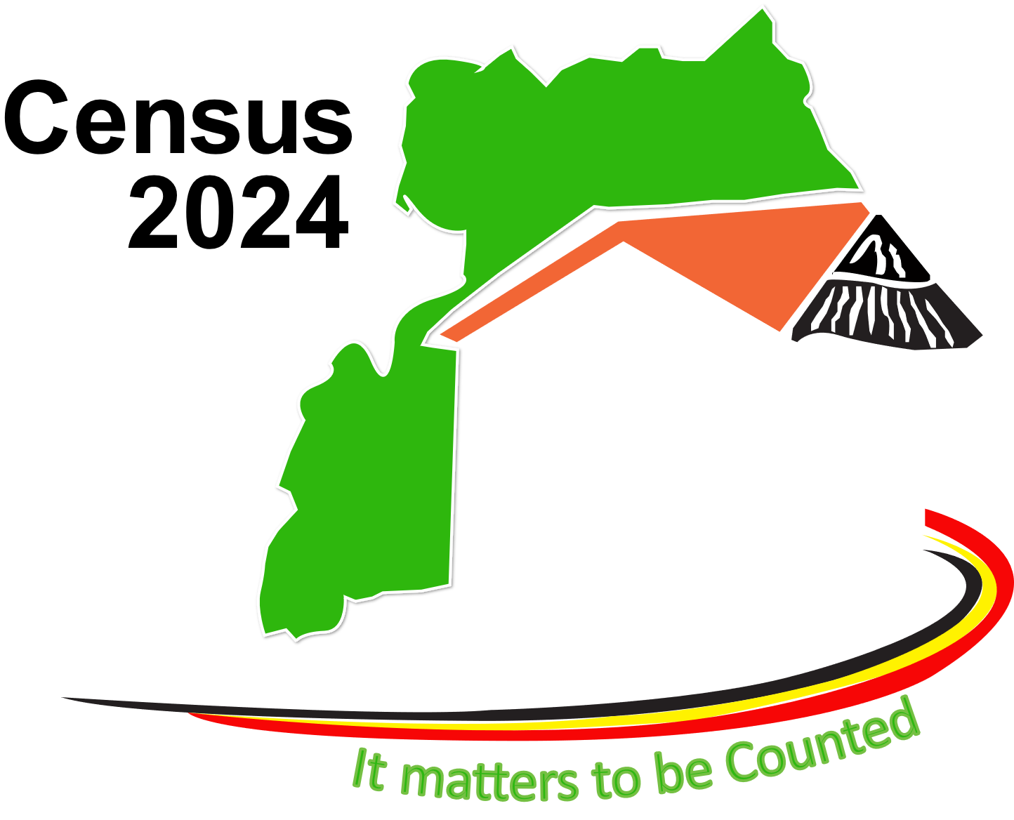


INTRODUCTION…
The National Population and Housing Census 2024 was conducted under the Uganda Bureau of Statistics Act, 1998 CAP. 310 Section 13
6th
Post
Independence Census
1st
Digital Census
11th
Uganda
Census
May 2024

Slide 5
CENSUS PROCESS
Post Enumeration
June 2024 - Dec 2025
Phase 03
Data Processing, Quality Assurance, Dissemination and Utilization of tablets after enumeration
Phase 02
Enumeration
10th – 26th May 2024
Counting of People and their characteristics, dwelling houses by type and facilities serving communities
Launch of Census
12th Dec. 2023
Continued with Census Mapping, Procurements, Recruitment and Training (Trainers and Enumeration staff) , Publicity and Advocacy

Slide 6

ENUMERATION PHASE
Reference Night
135,230
FIELD WORKERS
115,846 Enumerators
14,669 Enumeration Supervisors
4,715 Sub-County/Division Supervisors
5 sets of questionnaires
Door-to-door enumeration
9th -May 2024
Household,
Institution,
Accommodation,
Floating.
Community
(De facto census)
Enumeration days
Additional seven (7) days (20th – 26th May)
For mopping up in Greater Kampala
10th – 26th May 2024

Slide 7


ENUMERATION PHASE…
Special areas included
Uganda Prisons Service (UPS), Uganda
Police Force (UPF),
Uganda People’s Defence Forces (UPDF)
Diplomatic Missions
Refugee Settlements
Islands and off-shore communities
Cities
Automatic transmission of data to the central server
Data monitoring on the dashboard
Questionnaires uploaded onto the Computer Assisted Personal Interview devices.

Slide 8
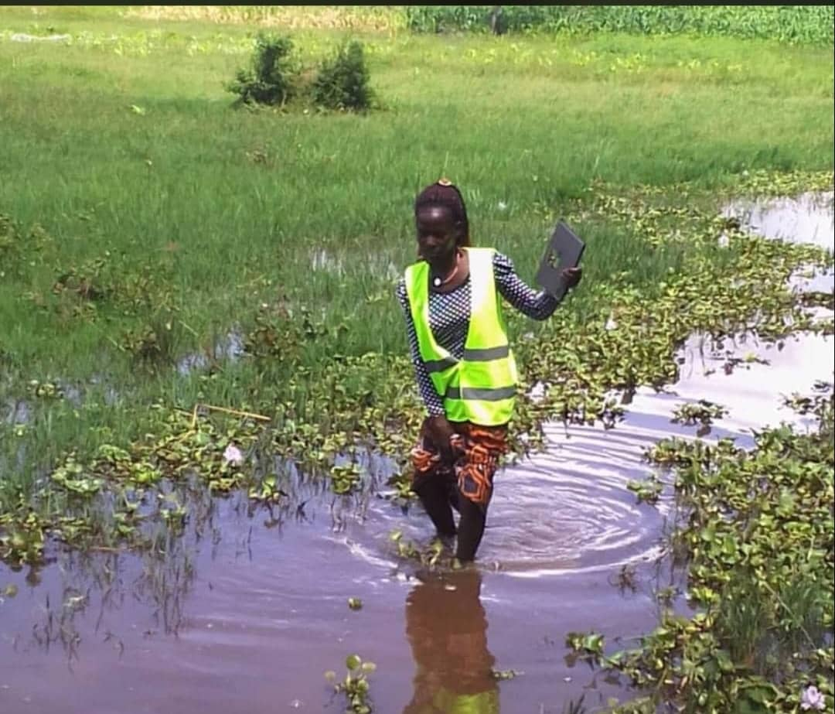
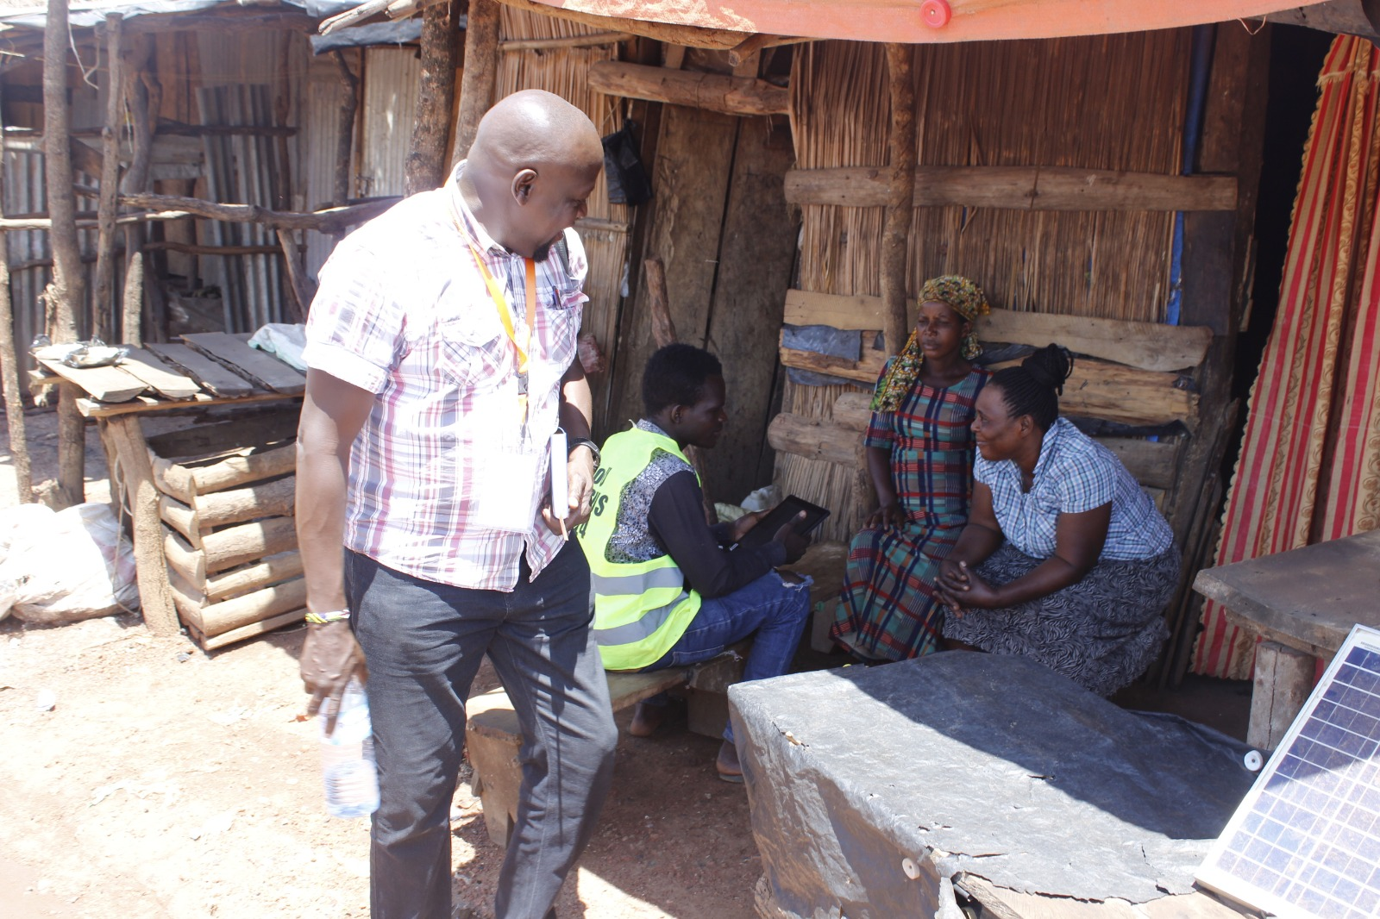

CHALLENGES FACED
1) Hard to reach areas
Islands
Mountainous areas
2) Greater Kampala Metropolitan
Hard to access
6) Internal border conflicts
Apaa – Amuru and Adjumani
Palaro – Gulu LG and Amuru
Ombechi/Kochi, Legu/Romogi, Gburule/Romogi – Yumbe and Obongo
Nyamisingiri – Kabarole and Ntoroko
3) Failure to access households
Gated households
Unavailable respondents e.g. single person households
Abeno Sharon braving through the waters to access households within her village in Kayunga District
Enumerators in Masaka LG travelling to Ggwamba Island where they were held hostage at night
4) Refusals
Religious cults
Deliberate refusals
5) Geography of some areas not updated on system
Enumeration in Apaa

Slide 9

SUCCESS STORY
Release of preliminary results a month after data collection
1st digital census in the country
Used personal phones for collecting community level data for some enumeration supervisors
27TH - June 2024
Census cost per capita was $1.9 compared to $2 in Kenya
Successfully collected comprehensive data using about 160 questions in the household and over 60 questions in the Community Questionnaire

Slide 10
DATA QUALITY ASSESSMENT
UN- Joint Score Index

Slide 11
DATA QUALITY ASSESSMENT
Age Heaping

Slide 12
CENSUS 2024 PRELIMINARY RESULTS

Slide 13

2024 POPULATION SIZE
Refugees
45.9 Million
780,061
Enumerated
34.6 M in 2014
Increased by 11.3 million persons since 2014

Slide 14


AVERAGE HOUSEHOLD SIZE
Households
2002
5,043,000
2012
7,245,245
2024
10,845,119
Notes:
REVISE 2024

Slide 15
Population Size (Millions)
Notes:
Add 2024

Slide 16
Intercensal Population by sex, 1911-2024
Females
51% of the total population.

Slide 17
Population pyramid
Age – Sex Composition of the Population 2024
Uganda is a young country with;
Children (0-17years) - 50.5%
Youth (18-30years) – 22.7%
Older persons (60+) – 5.0%
Working Age Population (14-64years) – 55.6%

Slide 18
Distribution of the Population ‘Millions

Slide 19
Population Growth Rate

Slide 20
POPULATION IN CITIES
City Name | Visitors (Day population) | Residents
KAMPALA | 627,340 | 1,875,834
MBARARA CITY | 63,318 | 261,656
GULU CITY | 91,165 | 232,723
MASAKA CITY | 42,976 | 285,509
HOIMA CITY | 48,633 | 141,442
LIRA CITY | 57,620 | 246,437
MBALE CITY | 81,685 | 289,941
JINJA CITY | 70,748 | 292,386
ARUA CITY | 59,716 | 380,824
FORT PORTAL CITY | 41,292 | 135,702
SOROTI CITY | 86,924 | 133,774
TOTAL | 1,271,417 | 4,276,228
Day population are persons who visited the city during daytime in the last 14 days prior date of enumeration

Slide 21



CONCLUSION
UBOS is very grateful to the Government of Uganda for conducting the first ever digital census in the country
To the Public; thank you for your cooperation, patience and being eager to be counted
UBOS is also thankful to all Stakeholders and Development Partners for the continued support towards strengthening statistical production in Uganda for evidence-based planning and decision making
Special appreciation for the job well done to ;
Enumerators
Census supervisors at all levels
Special enumerators and supervisors (Police, Prison, UPDF, UBOS Project staff and Foreign Affairs staff).
Electoral Commission and District/City Internal Security Organisation
Media

Slide 22

Conclusion - Next Steps
Undertake Post Enumeration Survey to check quality of the census data (content and coverage) in July 2024
Further data analysis and publication of final census results in September 2024
Production and publication of thematic reports, policy briefs, research paper, among others
Generating population projections and estimates
Updating the geography to village level
Uploading data on District/City portals for use
Archiving by Nov. 2025
Finalisation of post utilisation strategy of the tablets by Mar. 2025

